Slide 1
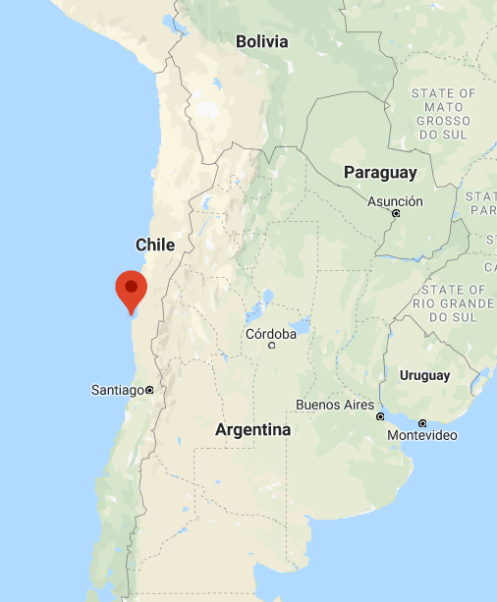

Diurnal and Low Frequency Northward Winds off Chile
Point Lengua de Vaca, Coquimbo, Chile
VOCALS CUpEx (2011)
Predominant equatorward winds are very strong, so reversed/weakened winds are v small
Significant upwelling site off Chile

Slide 2
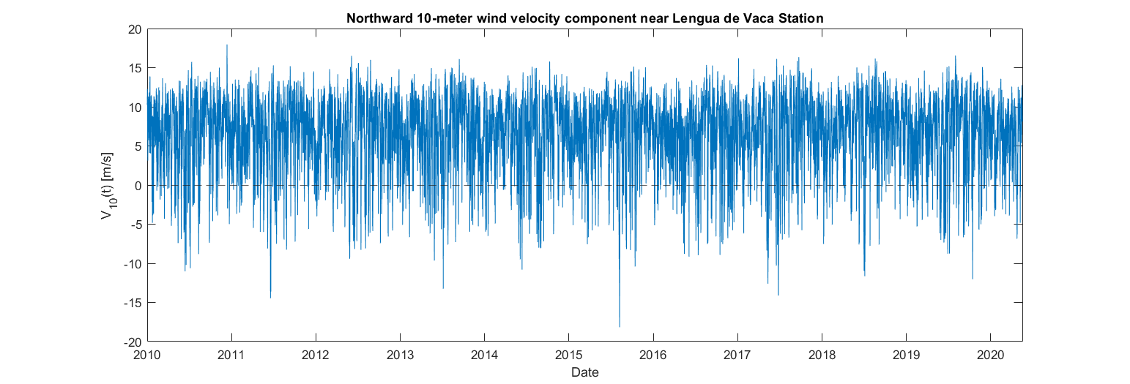
Scientific Question: How much of the northward wind speed variability in a month is diurnal or higher, and how much is a lower, frequency off of Chile? (10% in CCS Boreal Summer)

Slide 3
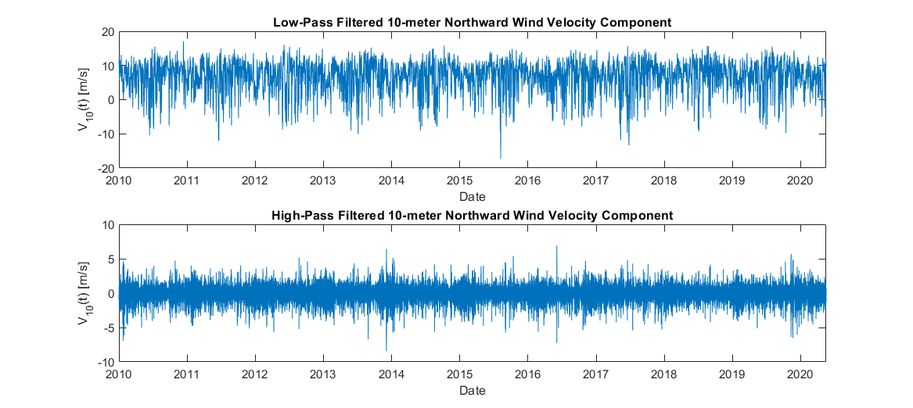
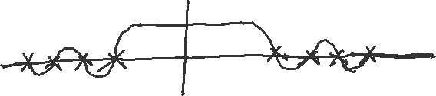
Methods
ERA5 Reanalysis
pl66 filter
Notes:
ERA5: the 5th iteration of re-analysis product from ECMWF
ECMWF: European Centre for Medium-Range Weather Forecasting

Slide 4
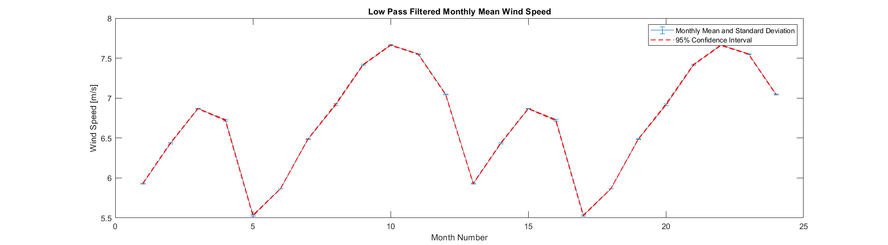
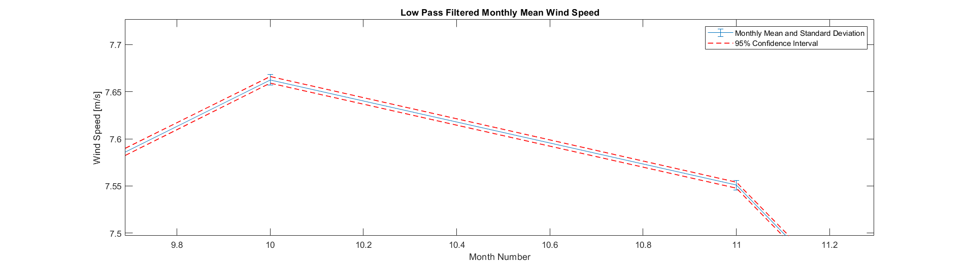
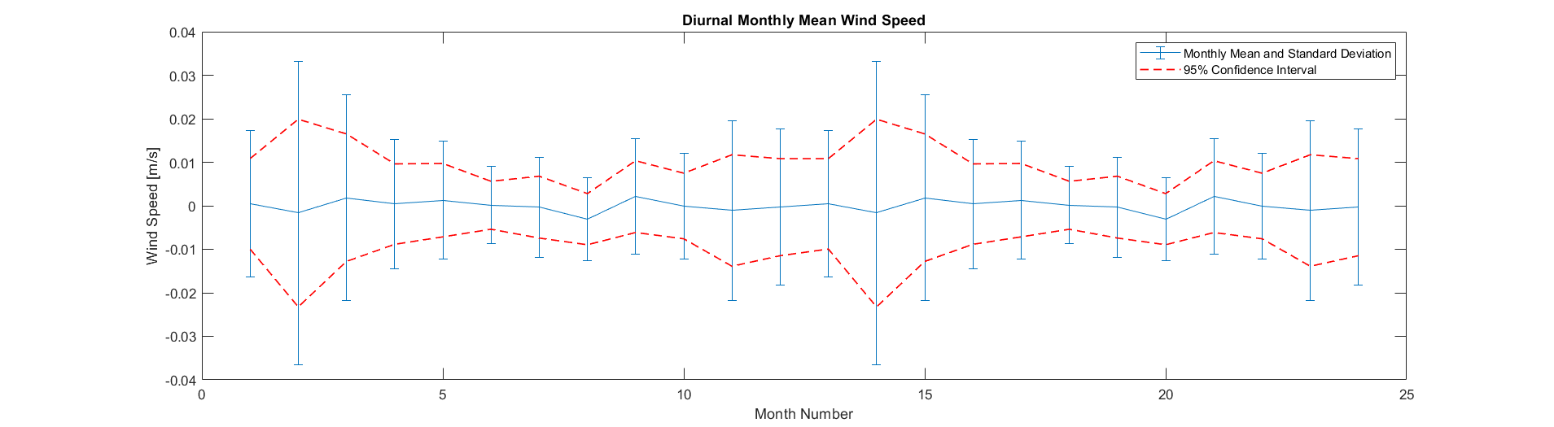

Slide 5
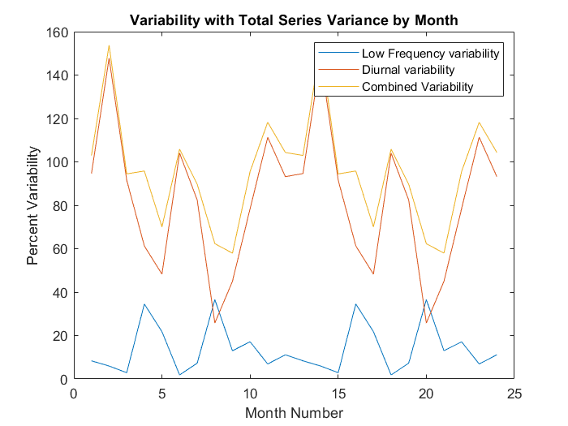
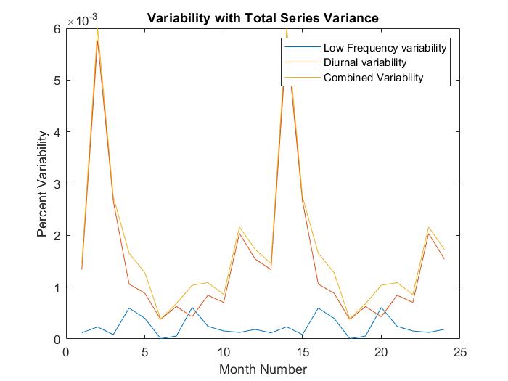
Areas to Explore Further
Fix standard deviation, confidence intervals, and variability. Probably need to look at what I considered to be independent observations and fix this, or consider the time series as a whole, instead of the monthly mean.

Slide 6
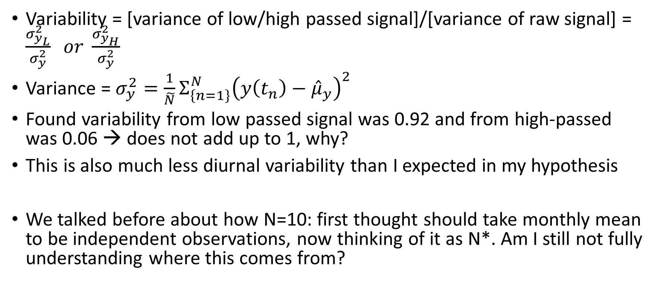
Variability in the whole time series
Variability = [variance of low/high passed signal]/[variance of raw signal] = $\frac{σ_{y_{L}}^{2}}{σ_{y}^{2}} or \frac{σ_{y_{H}}^{2}}{σ_{y}^{2}}$
Variance = $σ_{y}^{2}=\frac{1}{\tilde{N}}Σ_{\left\{n=1\right\}}^{N}{\left(y\left(t_{n}\right)−{\hat{μ}}_{y}\right)}^{2}$
Found variability from low passed signal was 0.92 and from high-passed was 0.06 → does not add up to 1, why?
This is also much less diurnal variability than I expected in my hypothesis
We talked before about how N=10: first thought should take monthly mean to be independent observations, now thinking of it as N*. Am I still not fully understanding where this comes from?

Slide 7
Goals and Tasks
This week:
This summer:
Keep working on why variability isn’t working out like I would expect
Take monthly means and look at that standard variability
Sorted into row vectors by month today
Fix monthly mean and standard deviation error bar graphs
EOF modes of northward component of wind velocity
Switch to wind stress (curl?)
Look at a location further from shore, possibly a “hot spot” of wind variability over the ocean from paper Melanie mentioned
Focus on variability in DJF
Original plan for class project that was too much then:
Identify possible relaxation times
Compare with literature (looked at some papers for PDO and ways others identify relaxations)
Mean and std for events (below some weak wind threshold)
Plan to continue through academic year? Yes
End of slides for 6/24/2020

Slide 8

Scientific Question: How much of the northward wind speed variability in a month is diurnal or higher, and how much is a lower, frequency off of Chile?

Slide 9
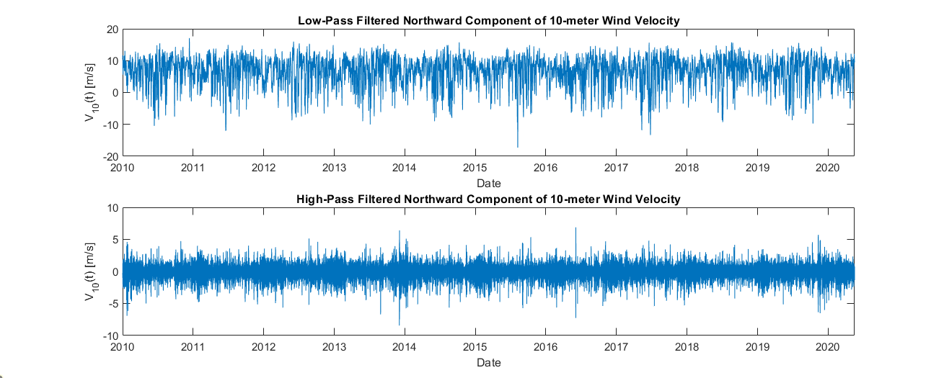
Methods
ERA5 Reanalysis
pl66 filter
Notes:
ERA5: the 5th iteration of re-analysis product from ECMWF
ECMWF: European Centre for Medium-Range Weather Forecasting

Slide 10
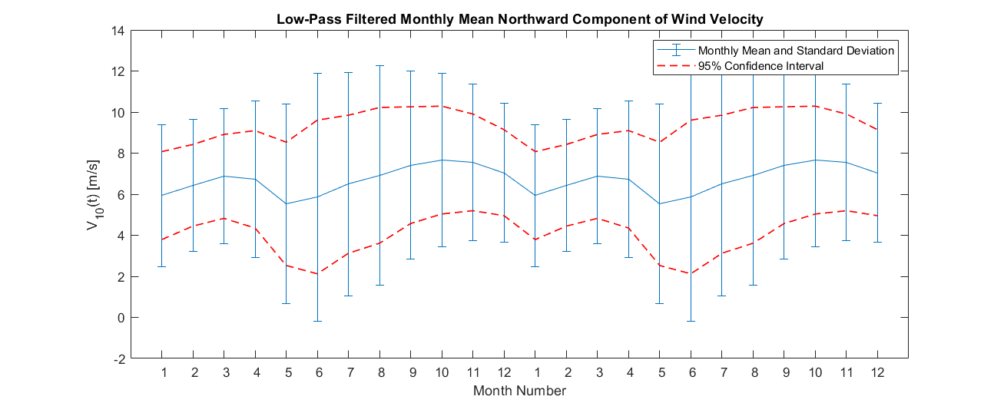
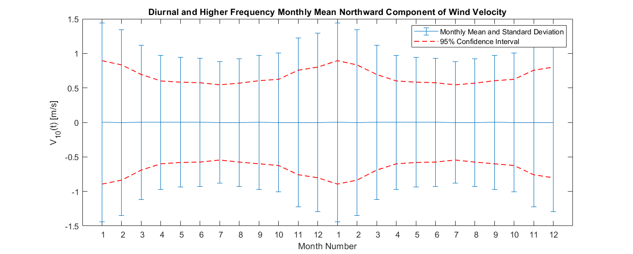
New mean and std with improved CI’s N = number of samples for mean and std N* = 10 for CI’s

Slide 11
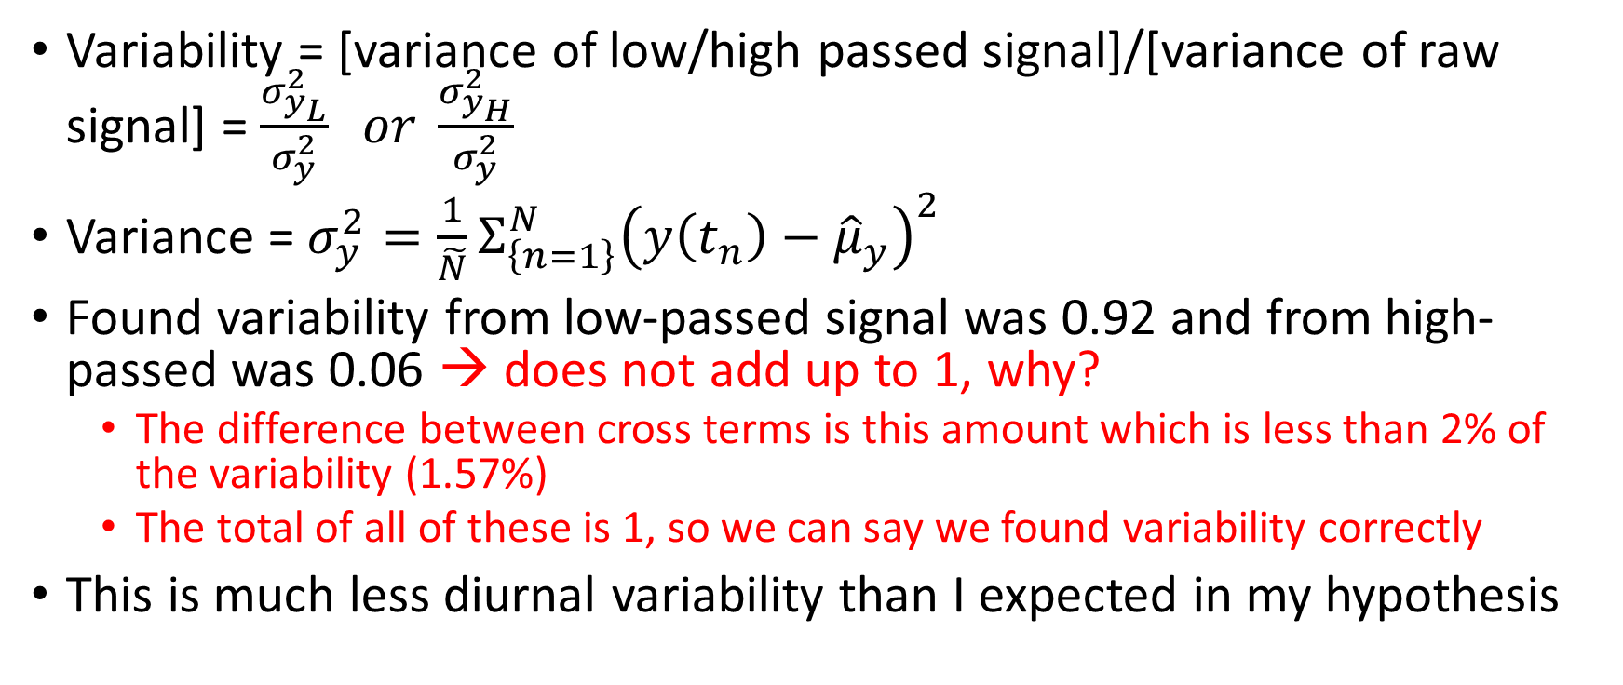
Variability in the whole time series (revisited)
Variability = [variance of low/high passed signal]/[variance of raw signal] = $\frac{σ_{y_{L}}^{2}}{σ_{y}^{2}} or \frac{σ_{y_{H}}^{2}}{σ_{y}^{2}}$
Variance = $σ_{y}^{2}=\frac{1}{\tilde{N}}Σ_{\left\{n=1\right\}}^{N}{\left(y\left(t_{n}\right)−{\hat{μ}}_{y}\right)}^{2}$
Found variability from low-passed signal was 0.92 and from high-passed was 0.06 → does not add up to 1, why?
The difference between cross terms is this amount which is less than 2% of the variability (1.57%)
The total of all of these is 1, so we can say we found variability correctly
This is much less diurnal variability than I expected in my hypothesis

Slide 12
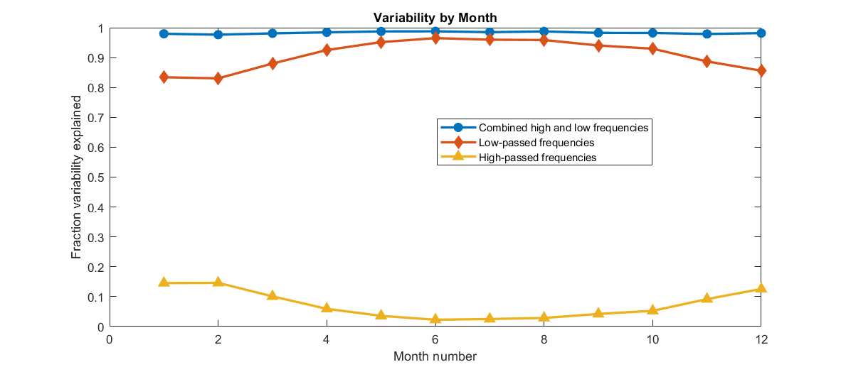
Variability explained by high and low-passed frequency signals
In this figure, we can see how the variability explained by the diurnal and higher frequency signal is on the order we expected in the hypothesis (at least 10%) for the months NDJFM. For the other part of the year, the variability is lower in this area of the Chile-Peru System than in the CCS.

Slide 13
Goals and Tasks
This week:
This summer:
Keep working on why variability isn’t working out like I would expect
Take monthly means and look at that standard variability
Sorted into row vectors by month today
Fix monthly mean and standard deviation error bar graphs
EOF modes of northward component of wind velocity
Switch to wind stress (curl?)
Look at a location further from shore, possibly a “hot spot” of wind variability over the ocean from paper Melanie mentioned
Focus on variability in DJF
Original plan for class project that was too much then:
Identify possible relaxation times
Compare with literature (looked at some papers for PDO and ways others identify relaxations)
Mean and std for events (below some weak wind threshold)
Plan to continue through academic year? Yes
End of slides for 6/24/2020

Slide 14
Tasks from last meeting
Seek help for pl66 filter with xarray
Add notes about what N* means in each case
New confidence intervals with N*’s
Read about OISST
Read Gentemann, et al. (2016)
Look at seasonal vectors of the “monthly averaged” product from ERA-5
Maps of each month
Time series of upwelling centers
w/ scaled wind vectors
Notes:
Did not get to the monthly averaged product from era5 this week

Slide 15
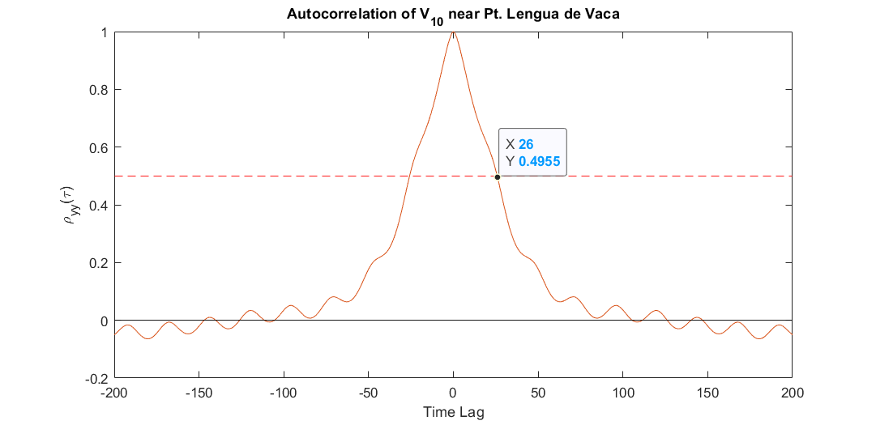
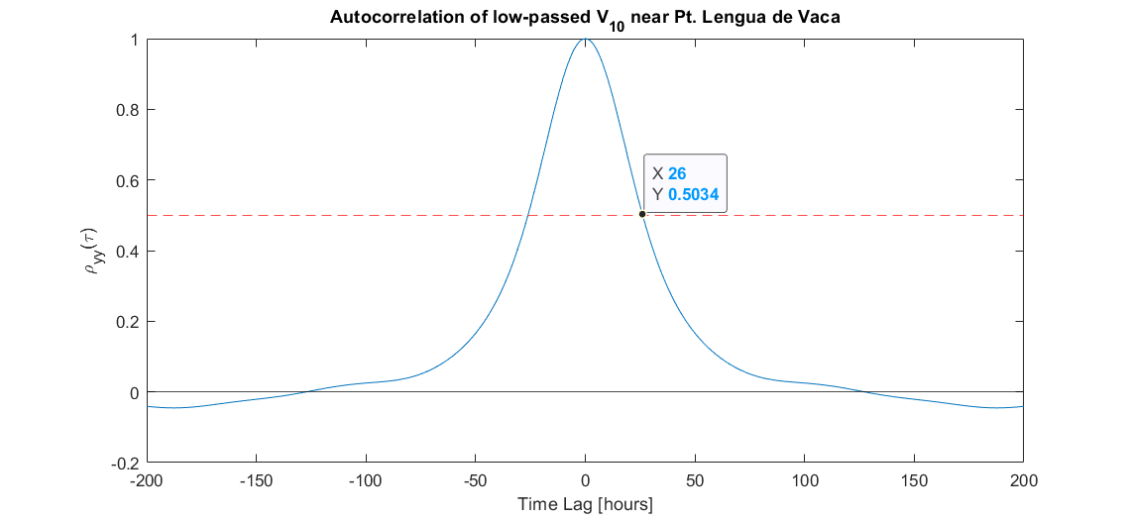
N* from Autocorrelation
Using “rule of thumb”:
T = 90934 hours
\tau^ind = 26 hours for entire time series and low-passed signal
N* = 350 ish
Notes:
This N* is useful for confidence intervals of independent synoptic-band events

Slide 16
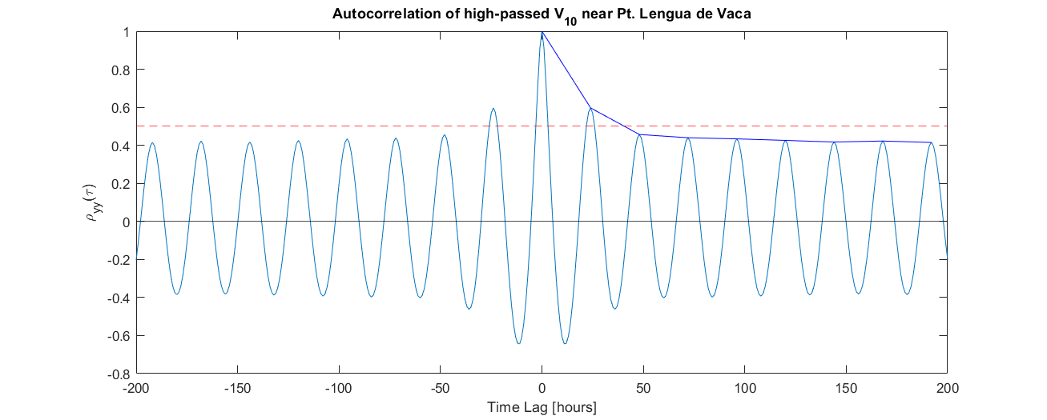
In contrast with the high-passed \tau^ind =38 N* = 2393
Notes:
N* for independent events on diurnal time scales.

Slide 17
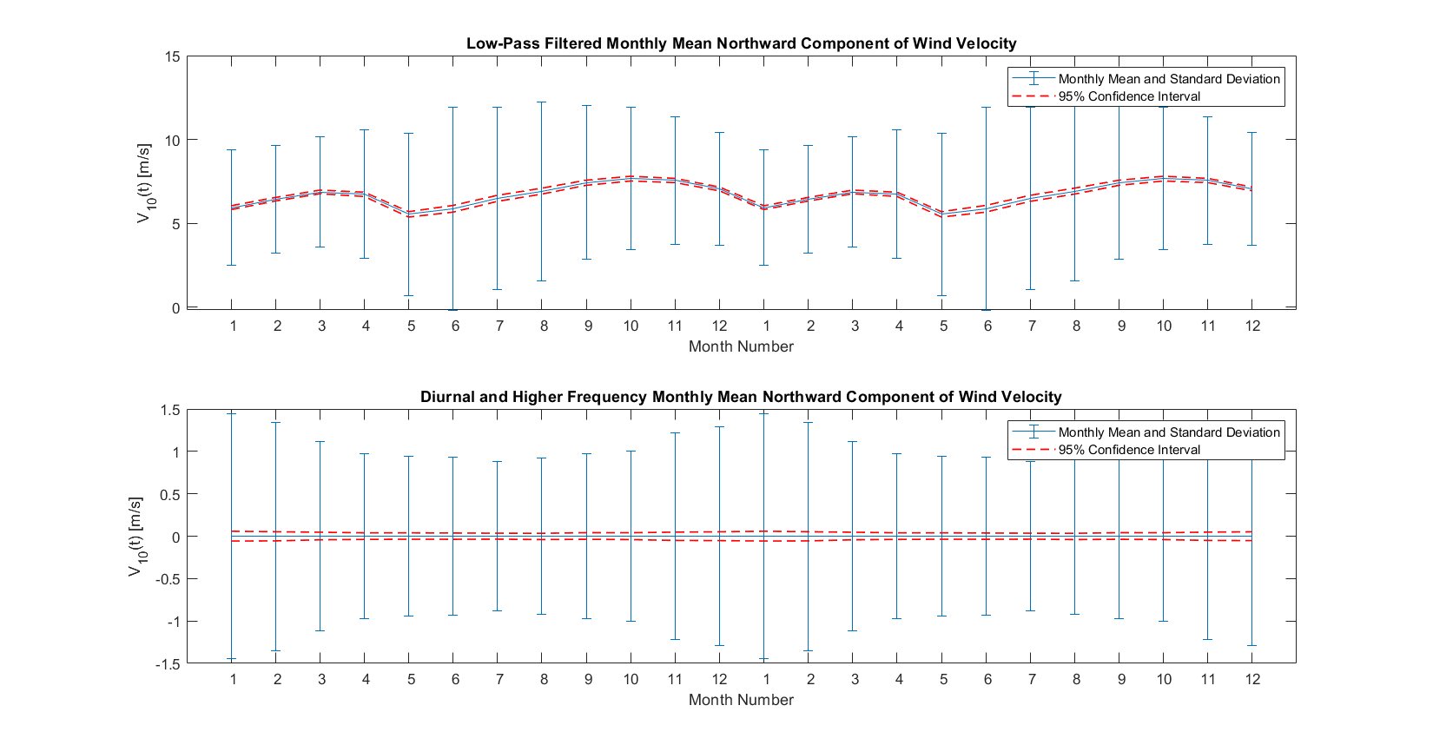
Adjusted CI’s with new N*
of
Notes:
Separately used the different N* values for each set of CI’s. Now they are much smaller that the standard deviation of the monthly mean from year to year. Will want to check the equation I used to calculate and an seek an explanation of its significance from 682 notes.
The CI’s were calculated using \pm(std)*(alpha/2 upper tail of normalized Gaussian distribution for alpha=0.05)/N* to give us the 95% confidence intervals as noted in the legends above. The narrowness of their range and resultant certainty in the measurement come from the large N*. Although the spread from (not independent events) many vary widely, we are much more certain of the mean.

Slide 18
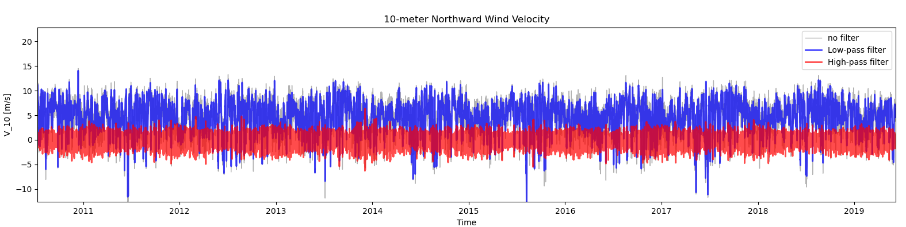
Using a Lanczos filter
Same 10-year dataset of 10-m northward component of wind velocity
Cutoff frequency of 1/33 hour**-1
121 sample window length

Slide 19
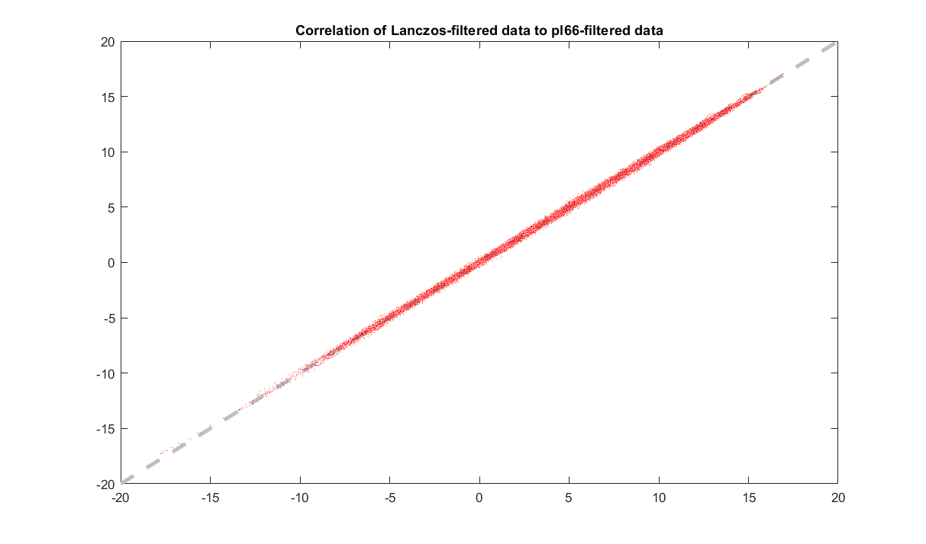
Does the Lanczos filter work approximately the same as the pl66 filter?
Notes:
After filtering the same dataset with the same window size (121 samples) and cutoff frequency (1/33 hr^-1), plotted low-passed signals against each other over a 1:1 line. Deviation from this is small by sight. The mean residual between the two signals is 0.006 m/s. While the low-passed signal has std of 4.4 m/s, the residual between the filters has a std 0.14 m/s. This difference in variability is at least one order of magnitude smaller than the winds we care about. Thus the Lanczos low-pass filter is an appropriate substitute for the pl66 low-pass filter.

Slide 20
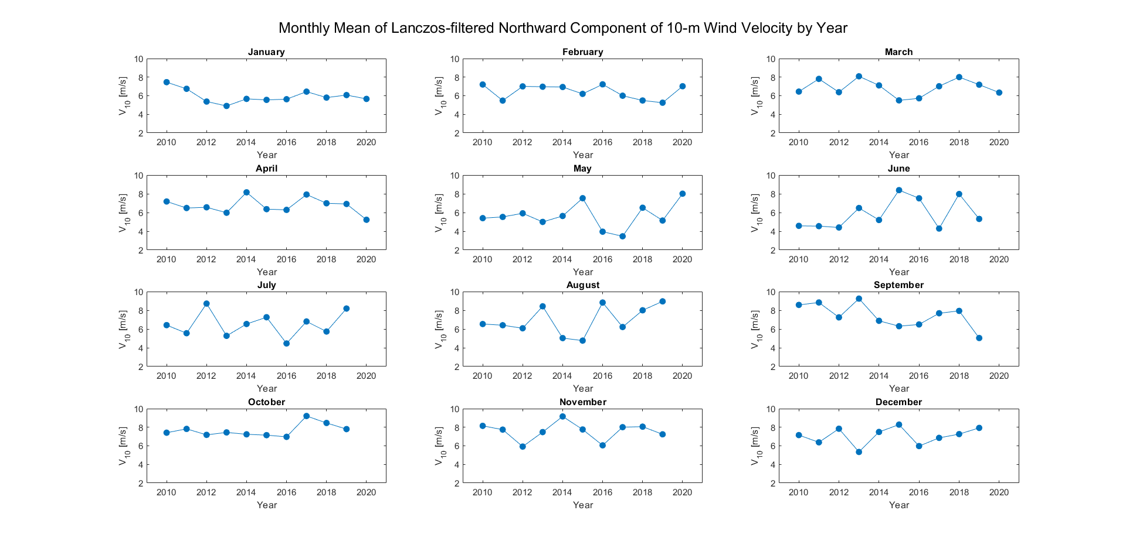
What is the interannual variability of monthly means of northward 10-m wind velocity?
Notes:
Typically the monthly mean of northward component of 10-m wind velocity is consistent over the ~10.5 year record. The biggest jumps in means have occurred in May through August.

Slide 21
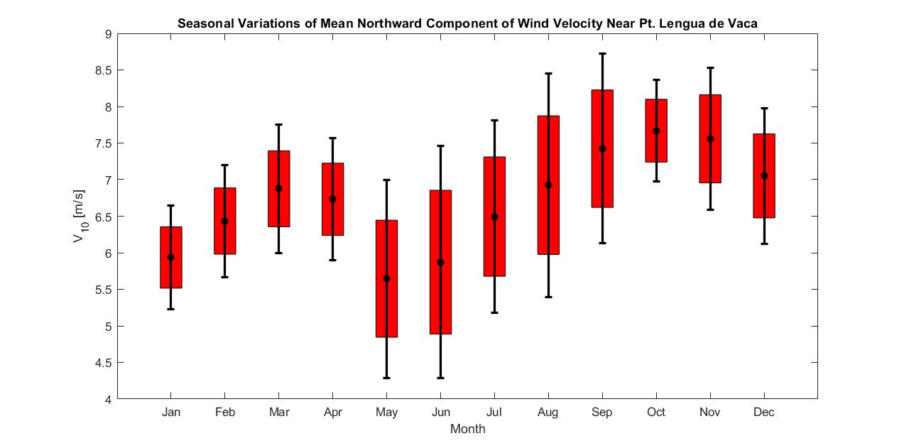
How do monthly means of northward 10-m wind velocity change seasonally?
Notes:
The monthly mean northward component of wind velocity stays poleward (upwelling favorable) year-round off Pt. Lengua de Vaca. We see the weakest upwelling-favorable winds, and greatest variability, in May and June (maybe through July) which is austral winter. (more frequent storms?) In this plot black points and error bars are mean monthly avg and standard deviation over the whole record. The red boxes are CI’s for the mean of the monthly means. N* is 11 for January through May, which may explain larger boxes in the second half of the year.
Black dots and error bars are mean +/- std of monthly means from previous plots

